Slide 1
What are Networks?

Slide 2
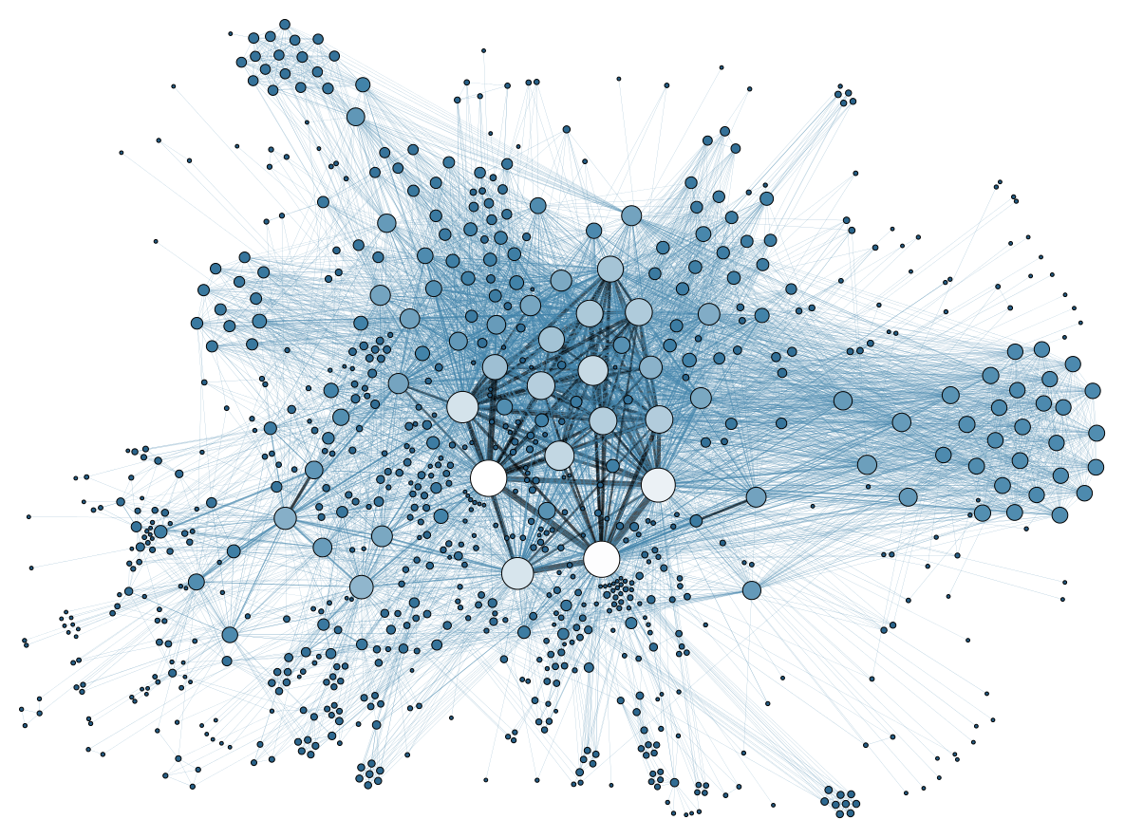
What is a network?
A set of entities
  Nodes, Vertices
Joined via a set of relations
  Links, Ties, Edges
In a point and line plot
  Entities are some shape (e.g., circles)
  Relations are lines

Slide 3
What is a network?
Don’t confuse pictures of networks with the real thing!
In a point and line plot
  Entities are some shape (e.g., circles)
  Relations are lines

Slide 4
What is a network?
Networks
Lots of things in the world are networks
Social
Technological
Biological
The Internet
Schools
Airports
The Brain
Instagram
Workplaces
The WWW
Ecosystems

Slide 5
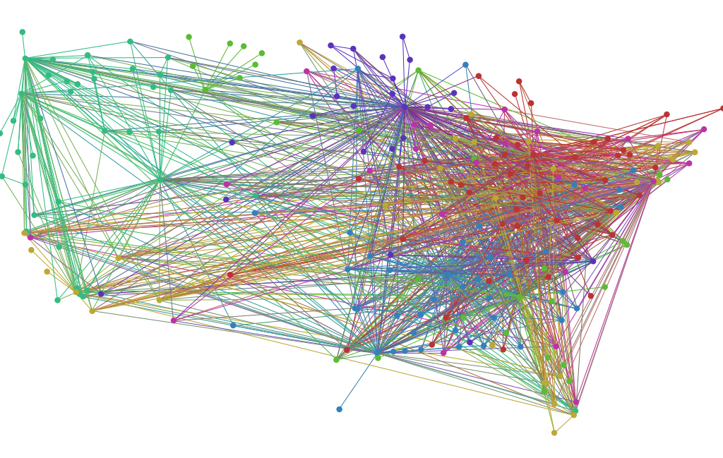
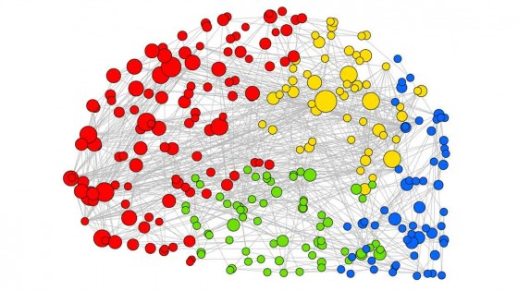
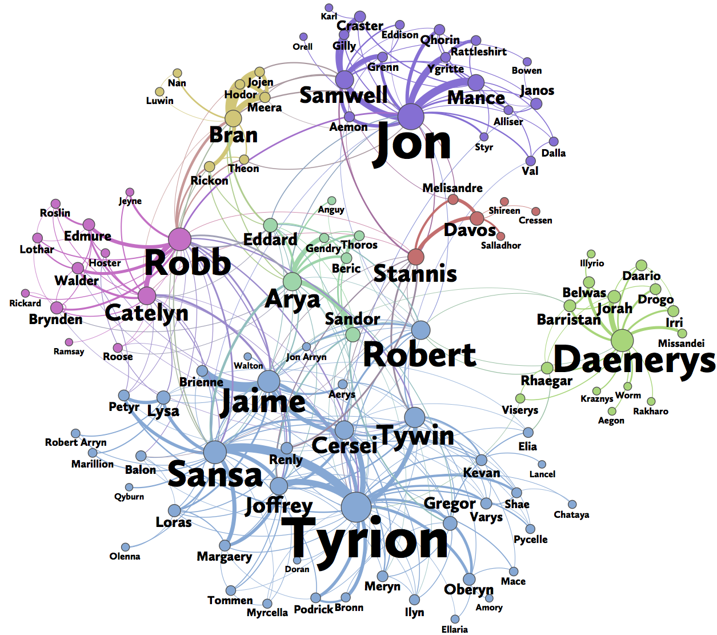
The Brain’s Neural Network
U.S. Airport Network
GoT’s Social Network

Slide 6
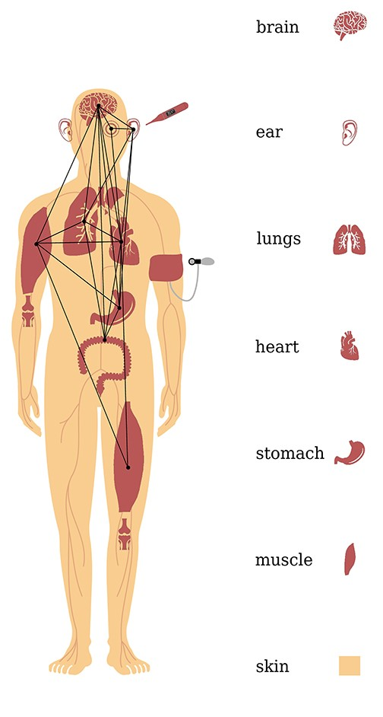
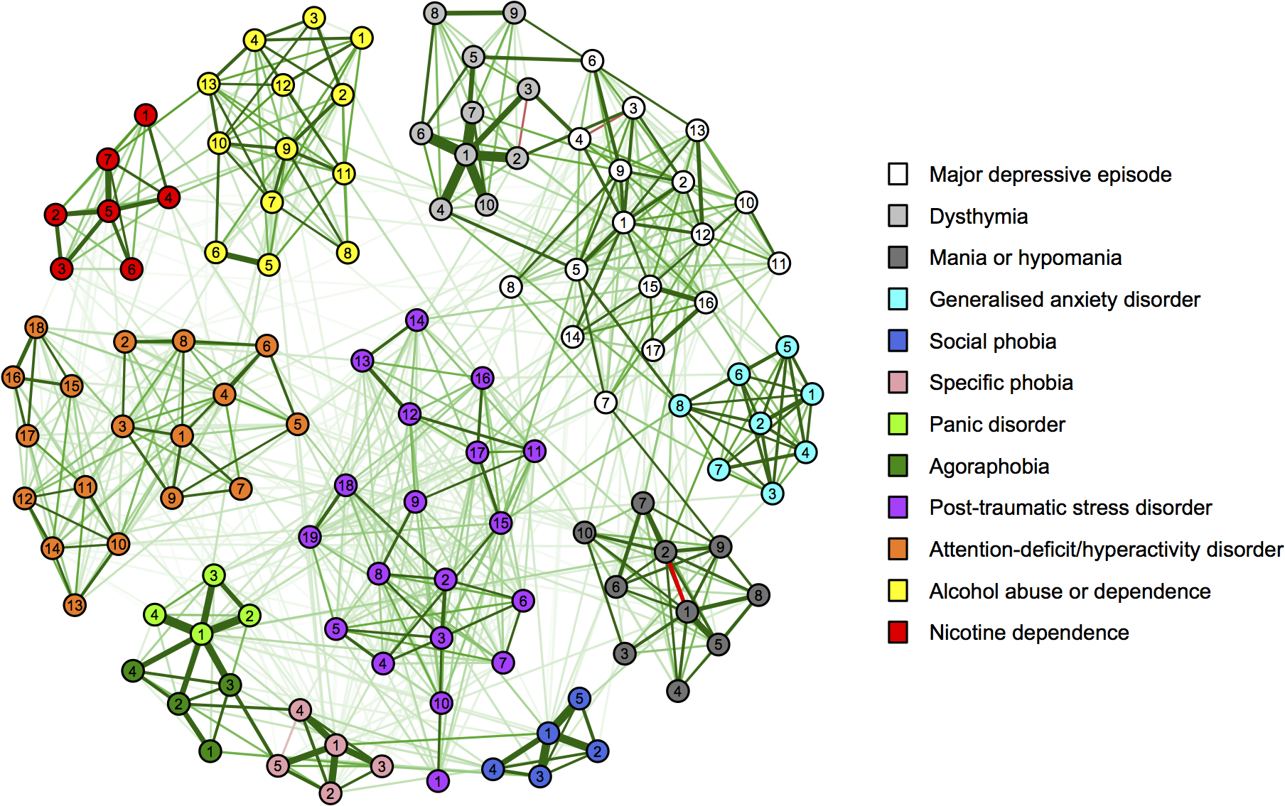
The Network of Psychological Symptoms
The Body’s Organ Network

Slide 7
Defining Social Networks
Networks are everywhere, but only a specific subset of them is actually a social network.
A network is "social" if it involves people (or groups) and their thoughts, interactions, and behaviors.
Even when we connect through technology (like texting or flying), it is the human interaction that makes it a social network.
In this class, we focus on the "purely social" elements: relationships, feelings, and how people exchange things.

Slide 8
What is a social network?
Networks
Some networks are social networks
Social networks link people
Via social relations
Social
Schools
Airports
Instagram
Workplaces
The WWW

Slide 9
What is a social network?
Networks
Some networks are social networks
Social
Schools
Airports
Instagram
Workplaces
The WWW

Slide 10
What is a social network?
Networks
Some networks are both social and technological
Technological
Airports
Instagram
The WWW

Slide 11
What is a social network?
Networks
Some networks are social networks
Some networks are “purely” social
Social
Schools
Workplaces

Slide 12
What is a social network?
Networks
Some networks are social networks
In this quarter we will learn about social network analysis (SNA)
Social
We will look mostly at “pure” social networks
Schools
Workplaces

Slide 13
The Roots of Social Network Analysis (SNA)
Social Network Analysis (SNA) is the main way we study these connections.
It grew primarily in the field of sociology, starting in the 1970s.
Today it is a team effort across different sciences, drawing on insights from multiple disciplines.
Social Network Analysis
Sociology
Anthropology
Psychology
Communication

Slide 14
What is a social network analysis?
Social Network Analysis
SNA is an interdisciplinary field in social science in charge of studying social networks
Sociology
Anthropology
Psychology
Communication

Slide 15
The Big Picture: Network Science
Network Science
SNA is just one branch of a much larger tree called Network Science.
Network Science studies all kinds of networks in the world.
This broader field includes experts from physics, computer science, biology, data science, and math.
Data Science
Psychological
Networks
Network Biology
Social Network
Analysis
Network
Neuroscience

Slide 16
What is network science?
Network Science
Psychological
Networks
Social Network
Analysis
Network Biology
SNA is part of the larger interdisciplinary field of Network Science
Data Science
Network
Neuroscience

Slide 17
Summary
Networks: Systems of entities linked by relations
  Different kinds: Social, biological, technological, etc.
Social Networks: Systems of interactive people (or groups of people) linked by social relations
Network Science: Interdisciplinary field in charge of studying all types of networks
  Biology, mathematics, computer science, physics, etc.
Social Network Analysis: Interdisciplinary field in charge of studying social networks
  Sociology, psychology, anthropology, communication

Slide 18
Summary
This course is about these two things!
Networks: Systems of entities linked by relations
  Different kinds: Social, biological, technological, etc.
Social Networks: Systems of interactive people (or groups of people) linked by social relations
Network Science: Interdisciplinary field in charge of studying all types of networks
  Biology, mathematics, computer science, physics, etc.
Social Network Analysis: Interdisciplinary field in charge of studying social networks
  Sociology, psychology, anthropology, communication

Slide 19


The two faces of Social Network Analysis
SNA has two main faces; the first is Network Theory.
Network Theory explains how networks work and what they do to the people inside them.
It tries to answer big questions: Why do people connect? How do they behave? What are the consequences?.
A great example is "social capital"—the idea that who you know brings you real-world benefits.

Slide 20
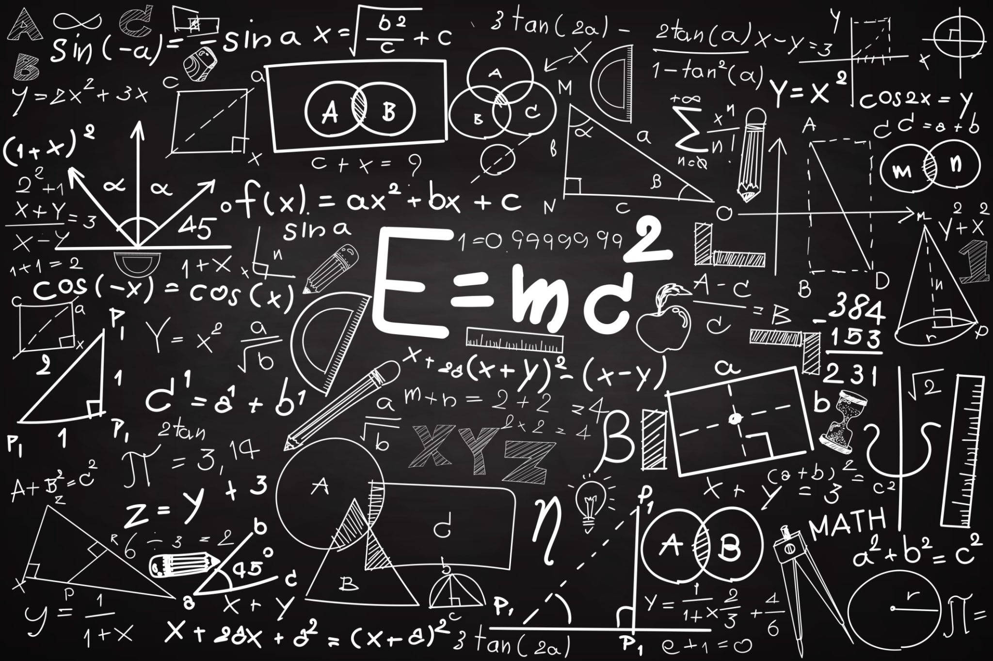
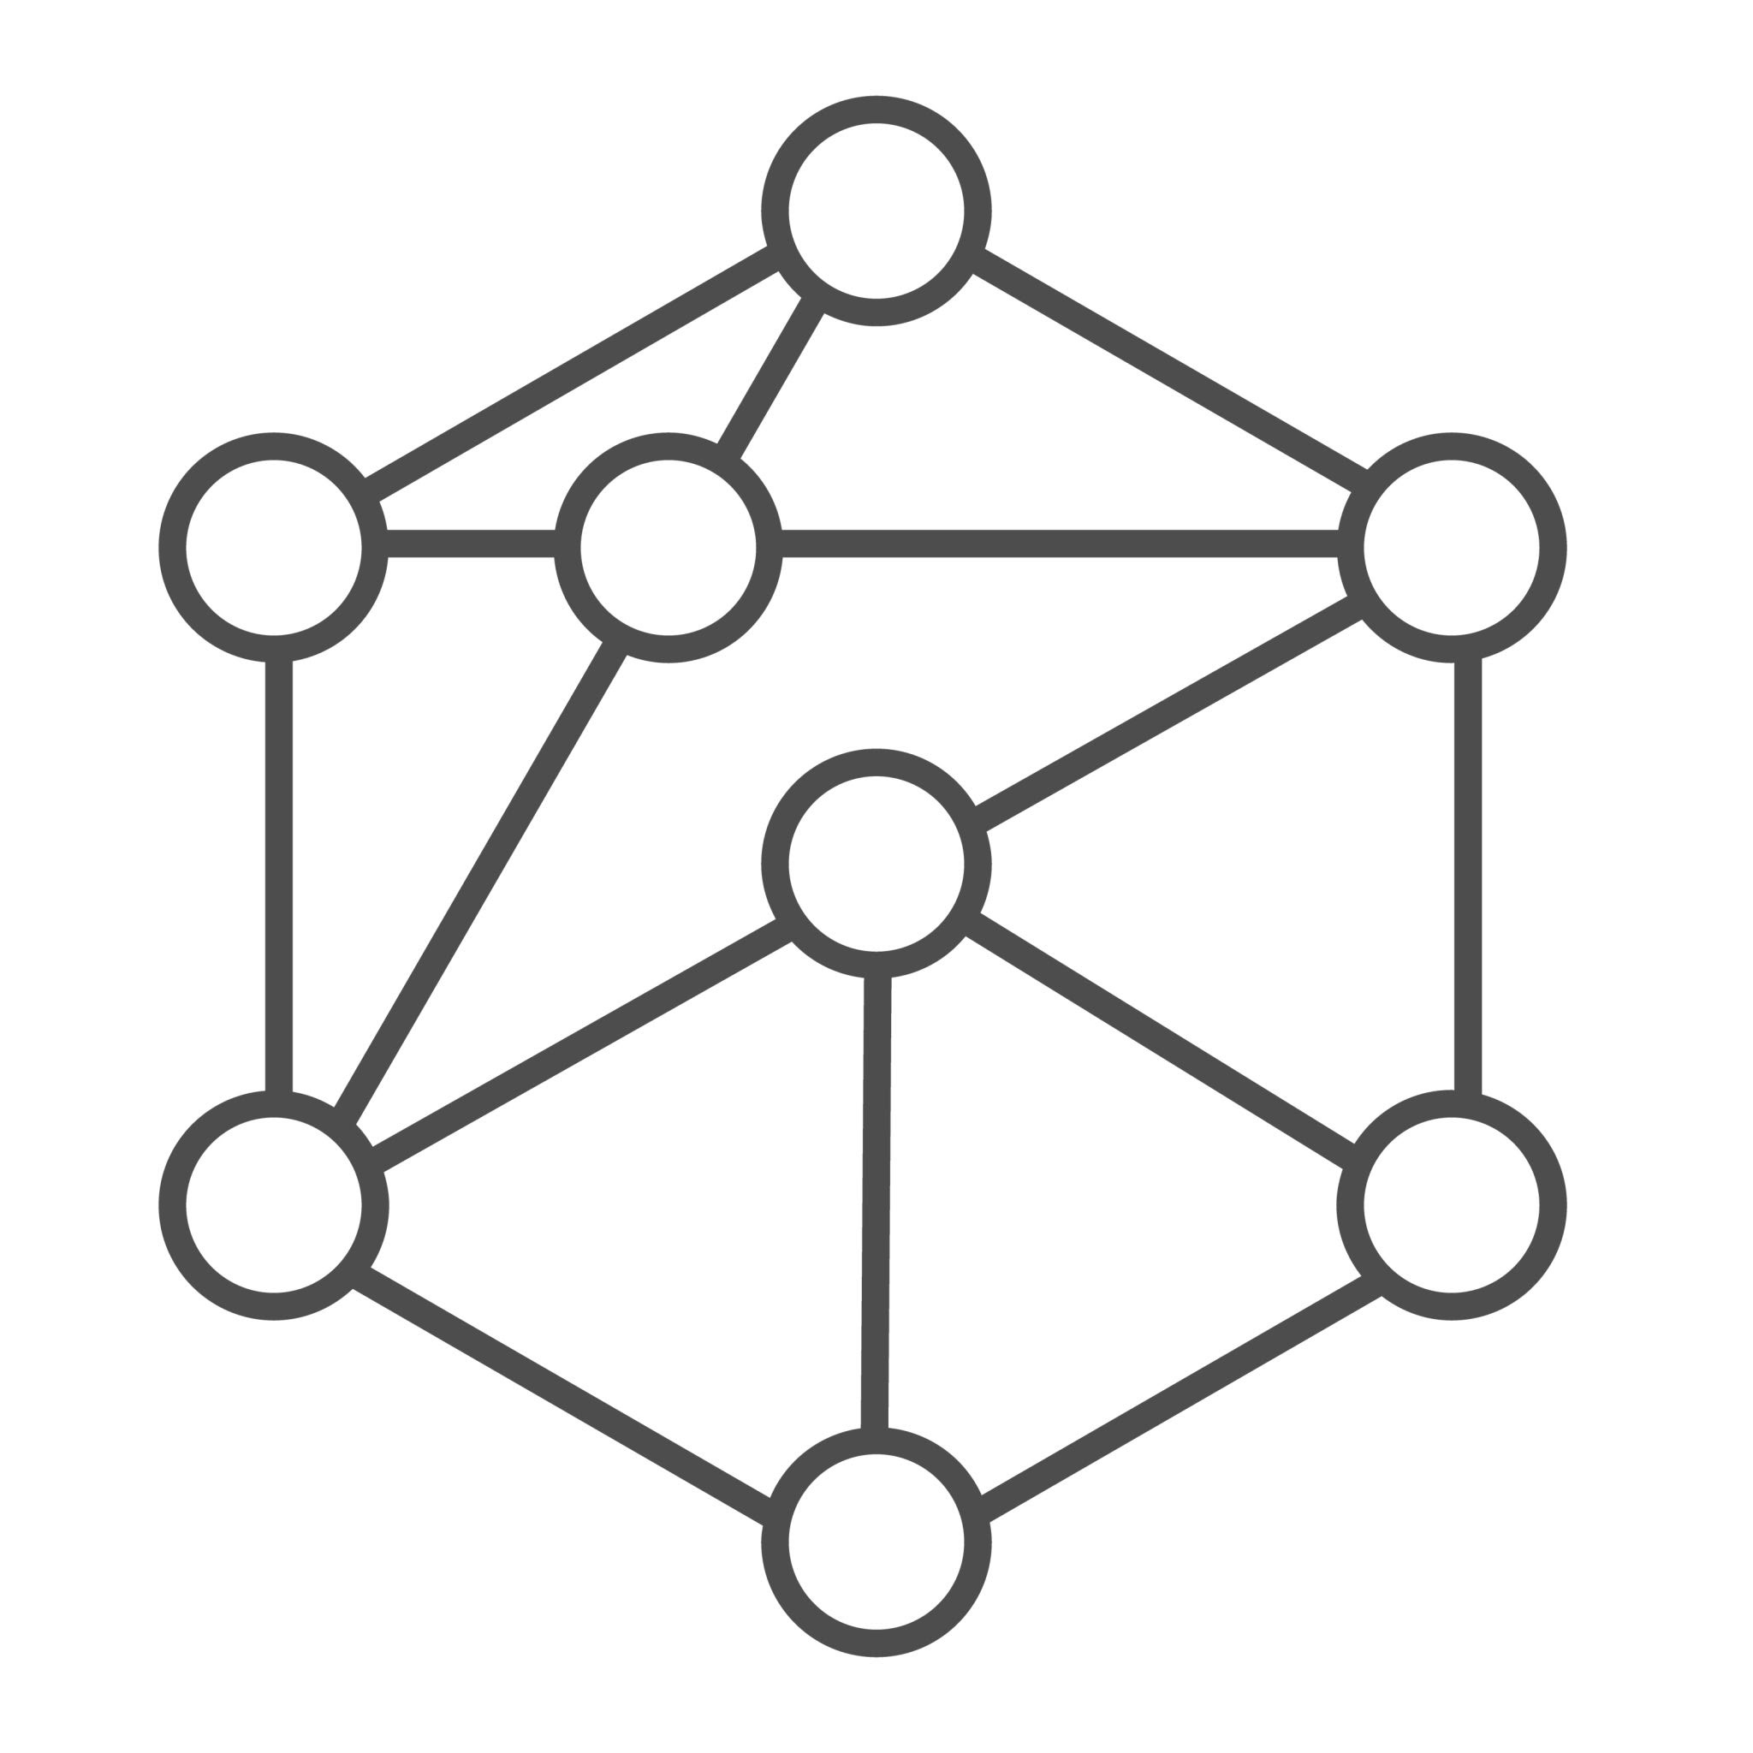
The two faces of Social Network Analysis
The second side of SNA is Network Measurement.
This is where we use math and numbers to measure network properties.
Math helps us take "fuzzy" social concepts—like "popularity" or "social position"—and turn them into precise, measurable quantities.
These numbers allow us to predict why some people, companies, or countries succeed while others do not.

Slide 21
Social Network Analysis
(SNA)
Social network theories are general statements about how people behave in networks
Social Network Theory
Social Network Measurement
Structural
Holes
Strength of Weak Ties
Degree
Centrality
Network
Density
The two faces of social network analysis

Slide 22
Social Network Analysis
(SNA)
Social network measurement helps make natural language concepts (e.g., “popularity”) more precise
Social Network Theory
Social Network Measurement
Structural
Holes
Strength of Weak Ties
Degree
Centrality
Network
Density
The two faces of social network analysis

Slide 23
Social Network Analysis
(SNA)
Social network measurement helps make natural language concepts (e.g., “popularity”) more precise
Social Network Theory
Social Network Measurement
Structural
Holes
Strength of Weak Ties
Degree
Centrality
Network
Density
The two faces of social network analysis

Slide 24


A “Graph”
Social Networks can be mathematically represented in two ways
We will learn how to go back and forth between the two
A “Matrix”
Two mathematical representations of networks

Slide 25
Levels of Analysis in social networks
Individual
1
Dyads
2
Triads
3
Cliques, Communities
4
Whole Network
5
We will be working through all these levels in the course!
(But not in this order)

Slide 26

Zooming In: Micro Levels of Analysis
We can study networks by zooming in very closely.
The Individual (Node) Level: We examine a single person and their personal connections, collectively known as their "ego network".
Small Configurations (Dyad/Triad Level): We look at relationships between two or three people.
  At this level, we study things like how strong a tie is, or how small groups balance their friendships.

Slide 27

Zooming Out: Macro Levels of Analysis
Communities (Subgroups): We look at larger clusters of people to see how close-knit they are.
The Whole Network: We look at the entire system to find large-scale trends, like whether the network is a "Small World".

Slide 28
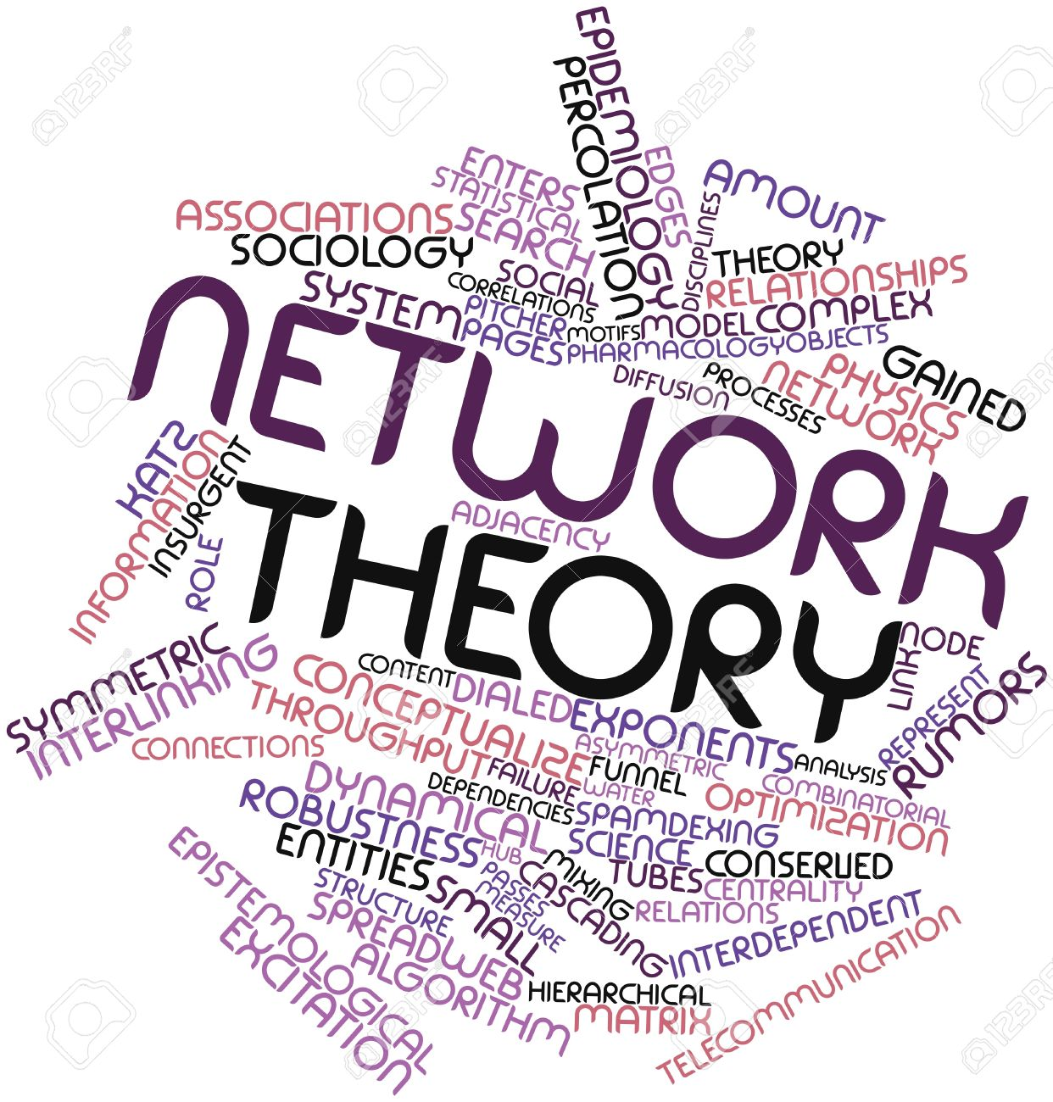
Three ways of talking about "social networks"
Social network theory is a branch of social science that uses natural language and intuition to describe real-world human interactions.
  Its concepts can be vague.

Slide 29
Three ways of talking about "social networks"
Social network theory is a branch of social science that uses natural language and intuition to describe real-world human interactions.
  Its concepts can be vague.
Graph theory is a branch of pure mathematics that uses less ambiguous terms to define "analogues" of these fuzzy social network concepts.

Slide 30
Three ways of talking about "social networks"
Social network theory is a branch of social science that uses natural language and intuition to describe real-world human interactions.
  Its concepts can be vague.
Graph theory is a branch of pure mathematics that uses less ambiguous terms to define "analogues" of these fuzzy social network concepts.
Matrix algebra is a branch of applied mathematics that links graph theory concepts to allow for calculations and the development of metrics for social network ideas (like "centrality").

Slide 31
The "Three-Step Shuffle"
A major goal of learning SNA is mastering three different ways to view networks.
  Seeing networks as real-world human interactions.
  Seeing networks as mathematical graphs.
  Seeing networks as quantitative data tables (matrices).
Transitioning smoothly between these three views is the key to understanding how networks work and change.

